Slide 1
Stock Analysis AI Assistant
Elimentary Technical Assignment
By Neil Shah

Slide 2
1. Approach
Developed a dual-role system for Analysts and Investors.
Used Streamlit for frontend and Python for backend.
Integrated Llama 2 model via Ollama for AI-based analysis.
Fetched real-time data using yfinance API.

Slide 3
2. Methodology
Fetched stock data from Yahoo Finance using yfinance.
Computed technical indicators (RSI, MACD, SMA, etc.) using `ta` library.
Generated AI-based analysis reports through Llama 2 model.
Implemented role-based access using JWT authentication.
Managed portfolios and reports through SQLite database with SQLAlchemy ORM.

Slide 4
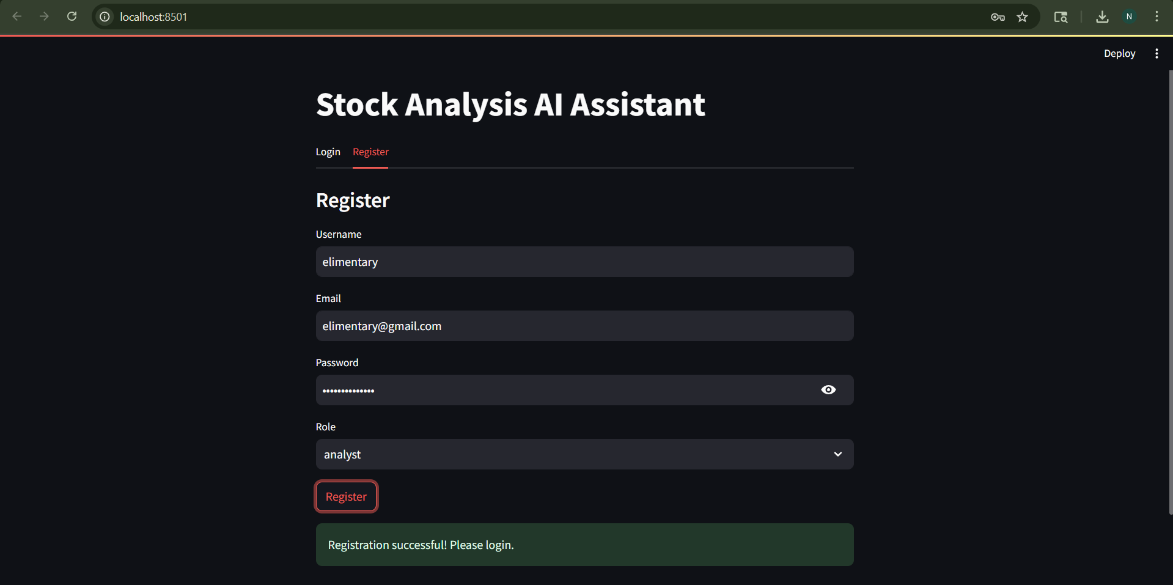
Sign up

Slide 5
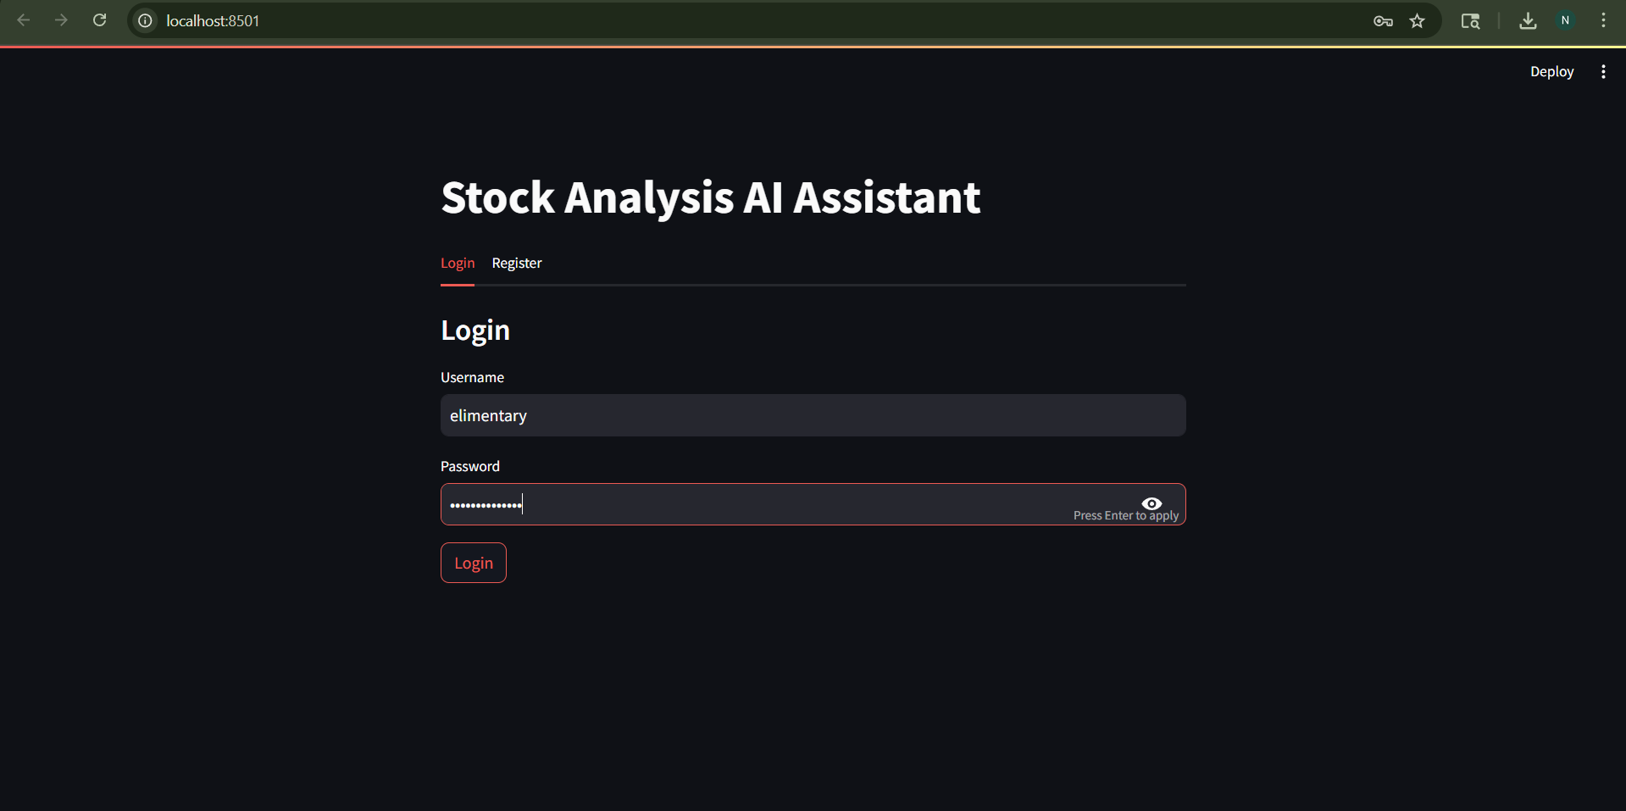
Login

Slide 6
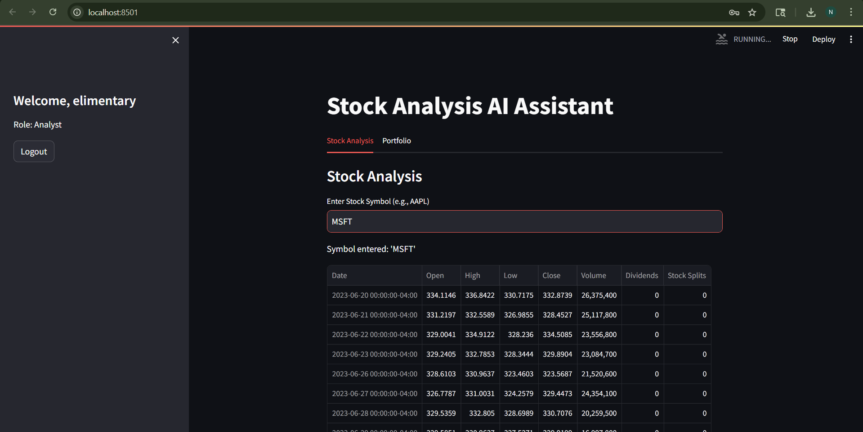
Stock Analysis Tab -Last 2 years Price

Slide 7
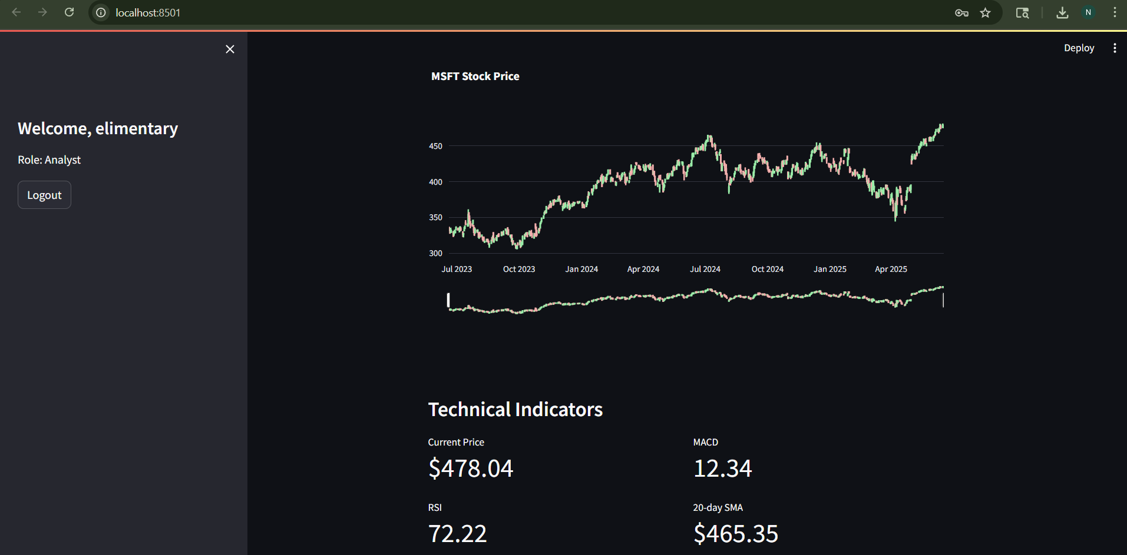
Stock Analysis Tab -Candlestick Graph and Computing Technical Indicators

Slide 8
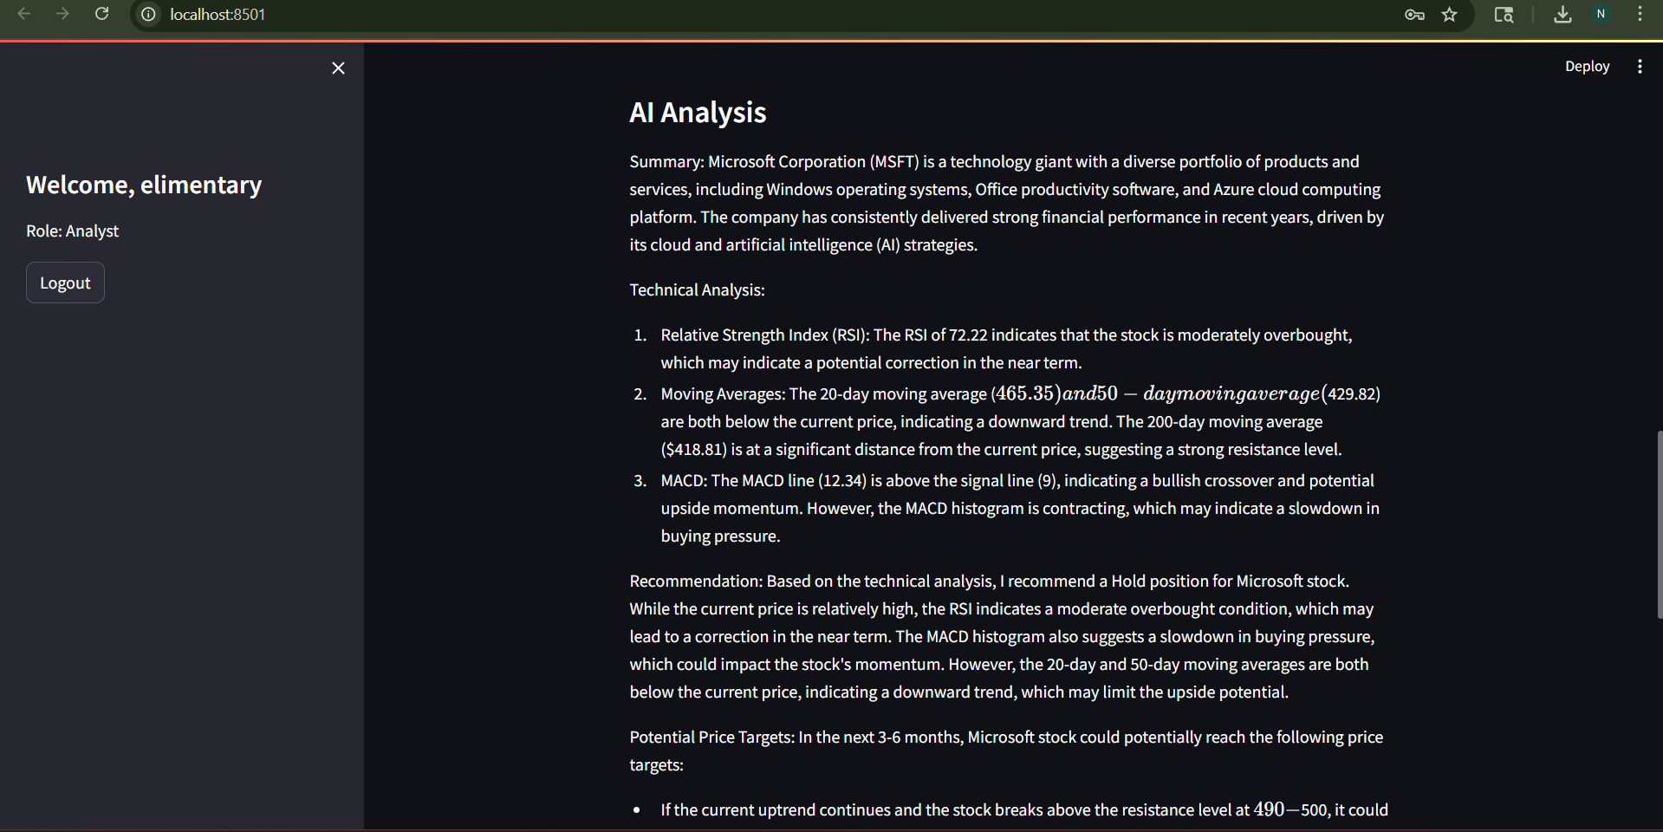
Stock Analysis Tab -ChatGPT like AI Analysis

Slide 9
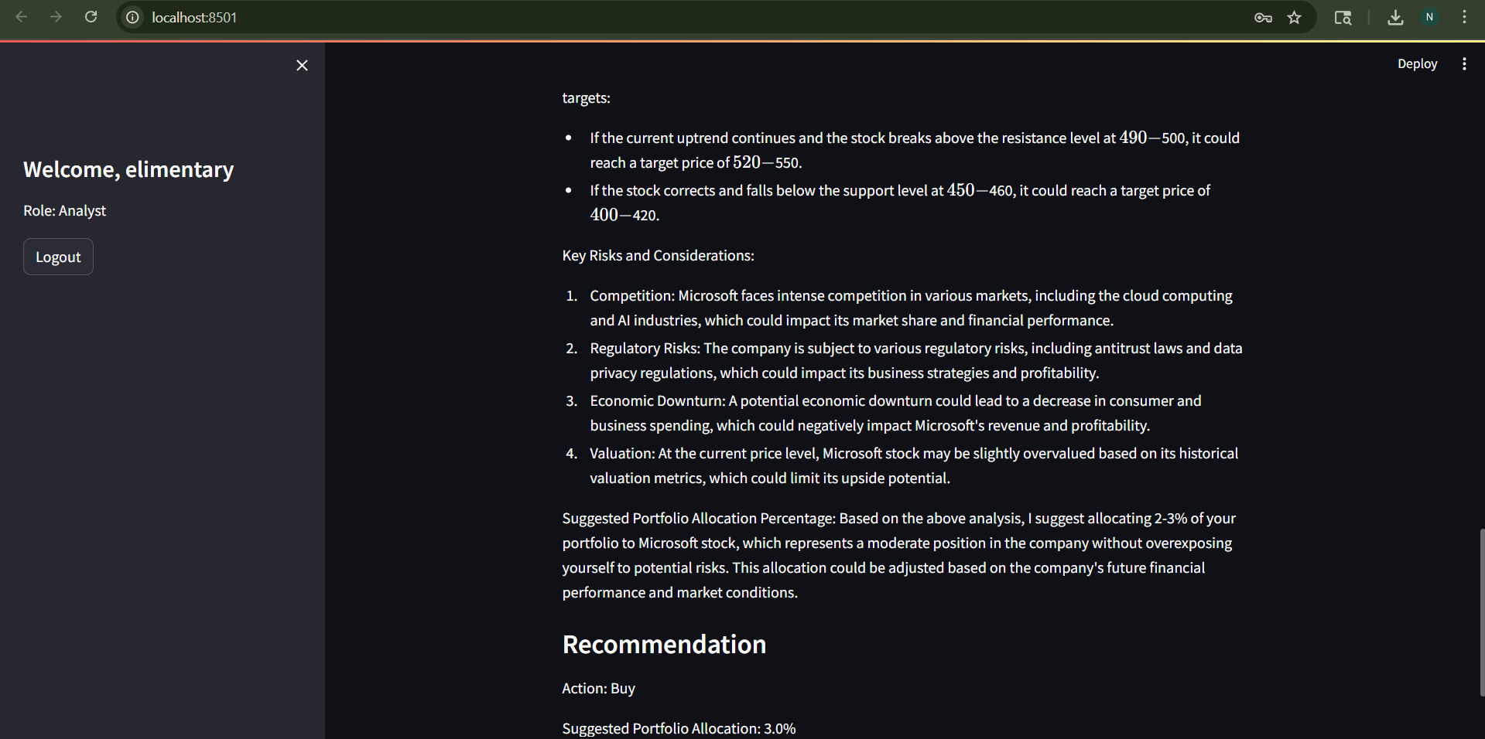
Stock Analysis Tab -Recommendation

Slide 10
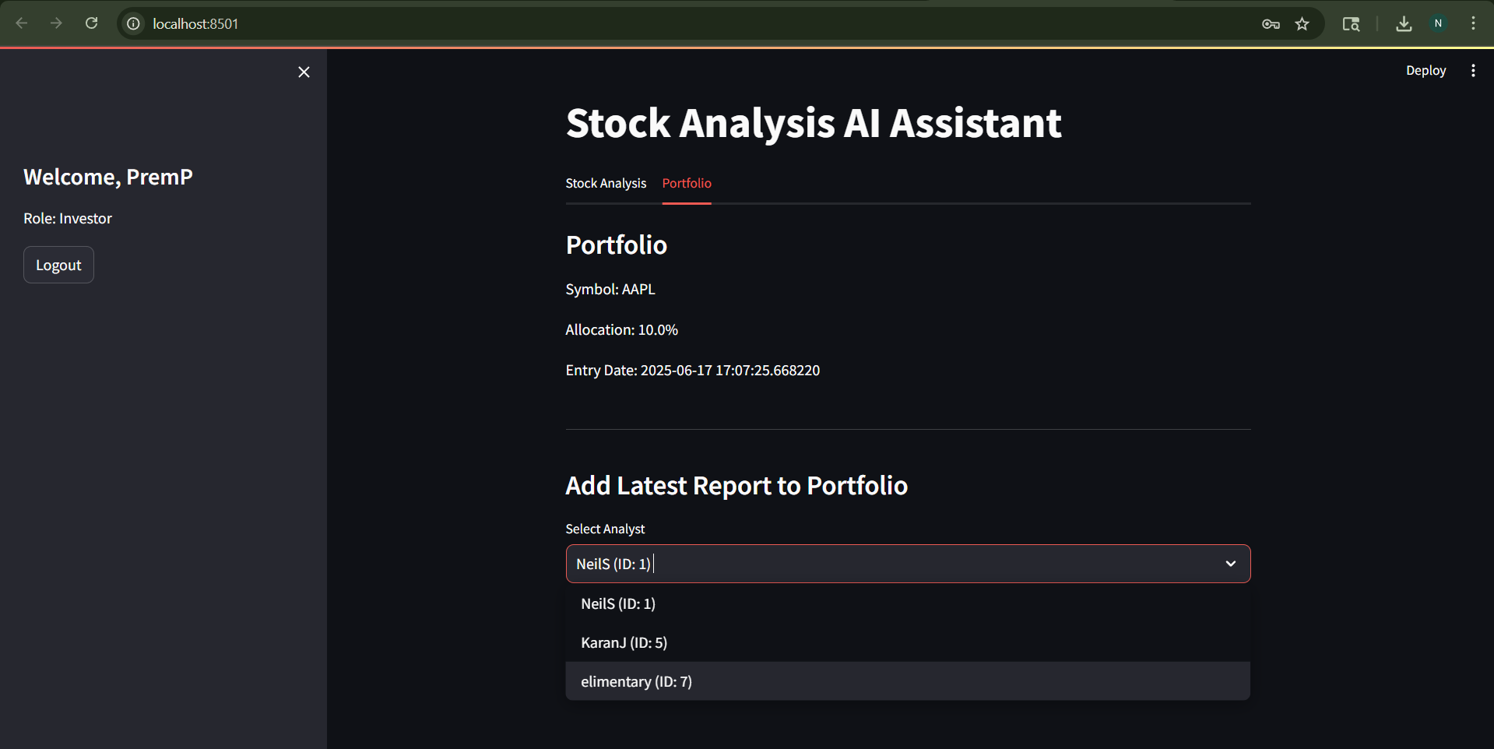
Portfolio Tab -For Investors
To view Past Reports and select Analyst

Slide 11
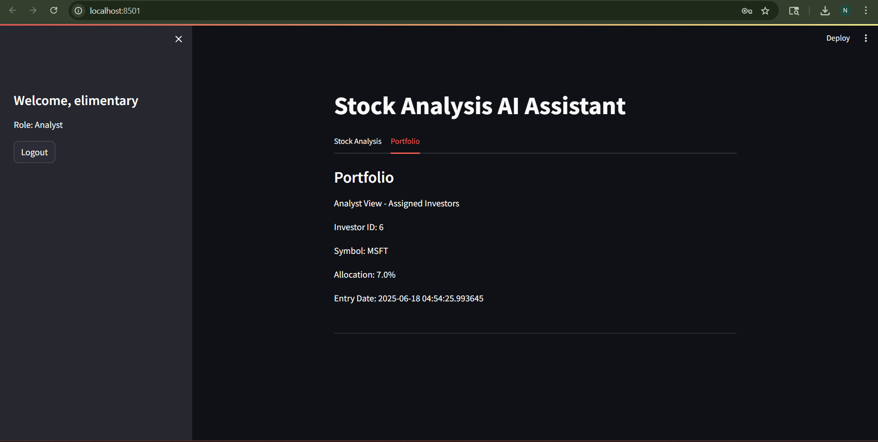
Portfolio Tab -For Analyst
To check investors assigned to a certain analyst

Slide 12
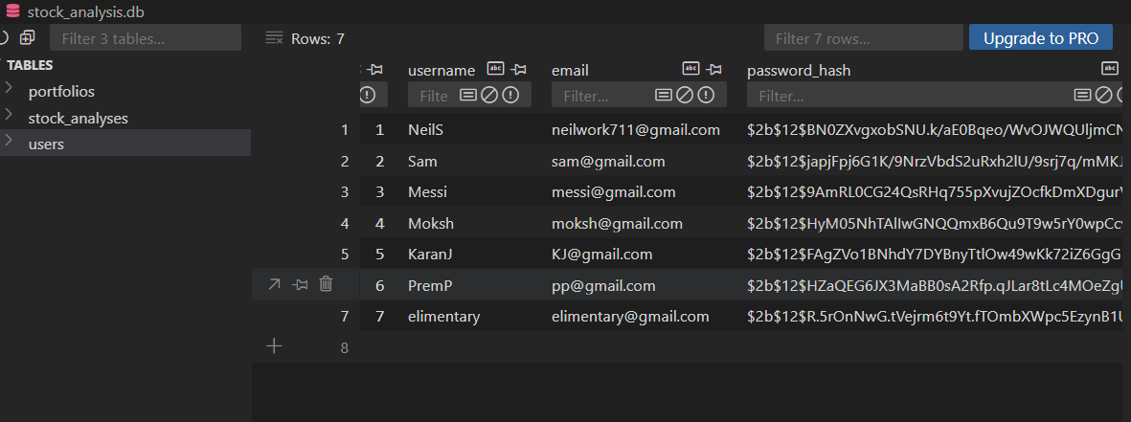
Security
Password Hashing used for security

Slide 13
3. Findings
System provides robust, real-time analysis for stocks.
AI-generated insights help in making informed decisions.
Role-based functionality enhances user experience.
Facilitates seamless report and portfolio management for both user roles.
Challenges like duplicate columns and data fetching errors were mitigated.

Slide 14
4. Future Improvements
Batch analysis and advanced technical indicators.
Improved visualizations and mobile-friendly interface.
Performance improvements via caching and async data fetching.
Scalability enhancements for larger datasets and more users.

